Slide 1
Day 2 – JavaScript Fundamental

Slide 2
What is JavaScript?
Don’t have to worry about complex stuff like memory management
JavaScript is a high-level, object-oriented, multi-paradigm programming language
Based on objects, for storing most kinds of data
Can use different styles of programming
Instruct computer to do things

Slide 3
A brief history of JavaScript
1995: Brendan Eich creates the very first version of JavaScript in just 10 days. It was called Mocha but already had many fundamental features of modern JavaScript.
1996: Mocha changes to LiveScript and then to JavaScript, in order to attract JAVA developers. However, JavaScript has almost nothing to do with JAVA. Later Microsoft launches IE, copying JavaScript from Netscape and calling it Jscript.

Slide 4
A brief history of JavaScript
1997: With a need to standardize the language, ECMA release ECMAScript 1 (ES1), the first official standard for JavaScript (ECMAScript is the standard).
2009: ES5 (ECMAScript 5) is released with lots of great new features.
2015: ES6/ES2015 was released: the biggest update to the language. ECMAScript changes to an annual release cycle in order to ship less features per update

Slide 5
A brief history of JavaScript
2016-going on: release of ES2016/ ES2017/ ES2018/ ES2019/ ES2020/………

Slide 6


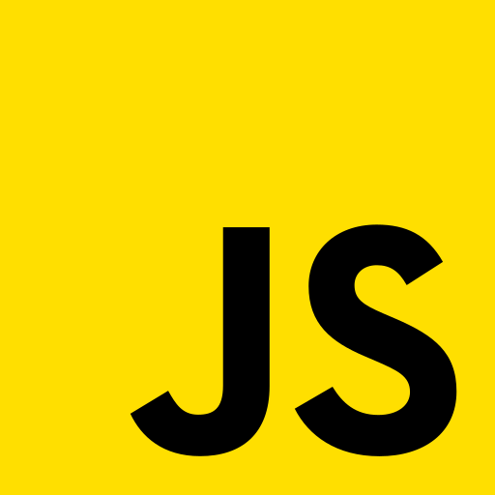
Part of JS in web development
Content
Presentation
Soul

Slide 7
Backwards compatibility: Do not break the web
But not forward compatibility
https://kangax.github.io/compat-table
Notes:
Old features are not removed
Not really new versions, just incremental updates
Website keep working forever

Slide 8
Variables and Values
“Hello World!!!!”
Value (Type: String)
Variable
messageToWorld
Variable Identifier
Notes:
Variables store value
Are data container
Reusablity and readability

Slide 9
Rules and best practices for variables
Should not contains whitespace or special characters (except $ and _)
Valid: $username, age, user_name, data$ ……
Invalid: %username, age/ , user name ……

Slide 10
Rules and best practices for variables
May contain numbers but must not start with a number
Valid: user3, us3r……
Invalid: 3user, 11player……

Slide 11
Rules and best practices for variables
Must not conflict with reserved keyword
Valid: user, password, age, data……
Invalid: class, if, while, const……

Slide 12
Rules and best practices for variables
Case sensitive

Slide 13
Rules and best practices for variables
Should use camel casing
Recommended: userName, firstName ……
uncommon: user_name, username……

Slide 14
Rules and best practices for variables
Should describe what the “things” it identifies contains or does
Recommended: isEnabled, password, apiResponse……
uncommon: xyz, thisisdata, correct……

Slide 15
Data Types
Primitive Type : Primitive types are basic, immutable (cannot be changed), and hold only one value at a time.
Objects: Objects are collections of key-value pairs and can hold multiple values of various types. They are mutable, meaning their content can be changed.

Slide 16




Primitive Data Types (7 Types)
Javascript has dynamic typing
Number: Floating numbers
String: Sequence of characters
Boolean: Logical type that can only be true or false
Undefined: Value taken by a variable that is not yet defined (empty value)
Null: Also means ‘empty value’
Symbol (ES2015): value that is unique and cannot be changed
BigInt (ES2020): Larger integers than the Number type can hold
Notes:
We do not have to manually define the data type of the value stored in a variable. Instead, data types are determined automatically.

Slide 17
Quick Question
Difference between NULL and undefined ????

Slide 18
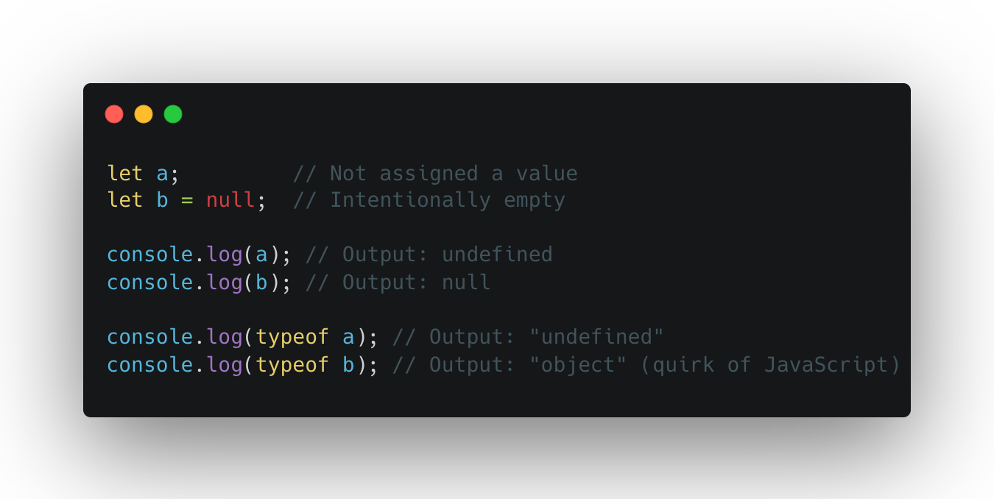
Quick Question

Slide 19
Primitive vs Objects
Aspect | Primitive Types | Objects
Mutability | Immutable: Cannot change the value itself | Mutable: Can modify properties or values inside.
Storage | Stores a single value | Can store multiple key-value pairs or data.
Data Structure | Simple data type (e.g., number, string) | Complex structure (e.g., arrays, objects)
Access | Direct access to value | Access through keys or methods
Example | let x =1; | let obj = {key: “value”}

Slide 20
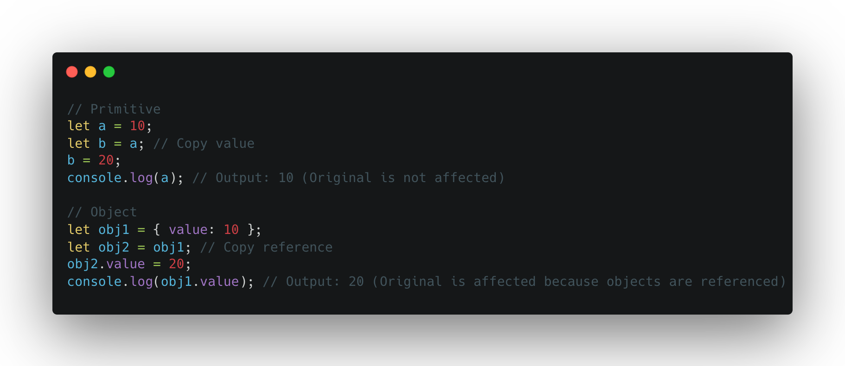
Primitive vs Objects

Slide 21
Operators
Arithmetic Operators (+, -, *, /, ++, --, **)
Comparison Operators (<, <=, >, >=, !=, ==, ===)
Logical Operators (AND -> &&, OR -> ||, NOT -> !)
Assignment Operators (+=, -=, *=, /=, %=, **=)
Notes:
A: Sarah has a driver’s license
B: Sarah has good vision

Slide 22
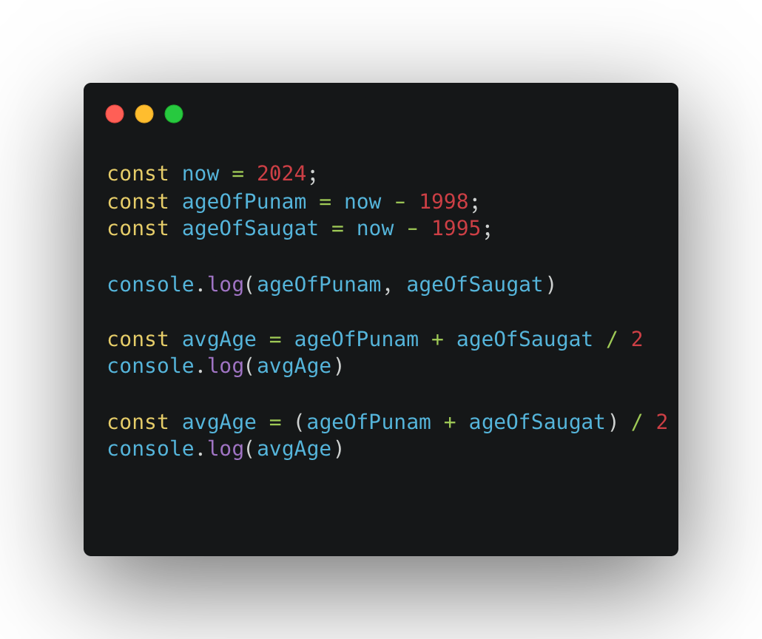
Operator Precedence
Learn more: https://developer.mozilla.org/en-US/docs/Web/JavaScript/Reference/Operators/Operator_precedence

Slide 23
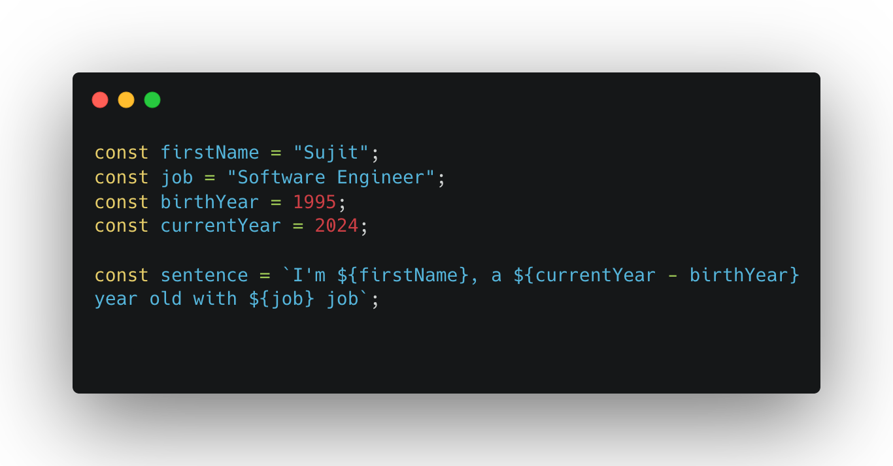
Strings and Template literals
Notes:
Template literals in JavaScript are a way to create strings with more flexibility. They allow embedding variables, expressions, and multiline text in strings without using cumbersome concatenation (+) or escape characters.
Key Features:
Use Backticks (``): Template literals are enclosed by backticks instead of single or double quotes.
Interpolation: Embed variables or expressions using ${...}.
Multiline Strings: Write strings across multiple lines easily.

Slide 24
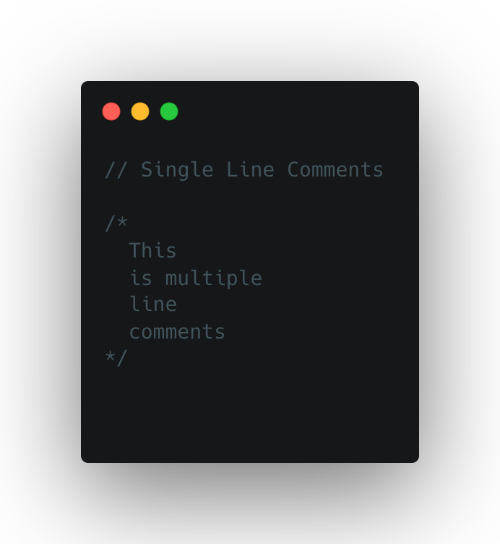
Comments

Slide 25
Conversion and Coercion
Aspect | Conversion | Coercion
Definition | Explicitly changing a value’s data type. Typically done manually by the programmer | Implicitly changing a value’s data type, done automatically by JavaScript
Control | Full control: The programmer decides when and how the conversion happens | Automatic: JavaScript decides when and how to perform the type change
Example | Using type conversion function like Number(), String(), or Boolean() | Automatic type change during operations like +, ==, or logical expressions.
Predictability | More predictable since it is explicitly stated in the code. | Can be unpredictable and may lead to unintended behavior.

Slide 26
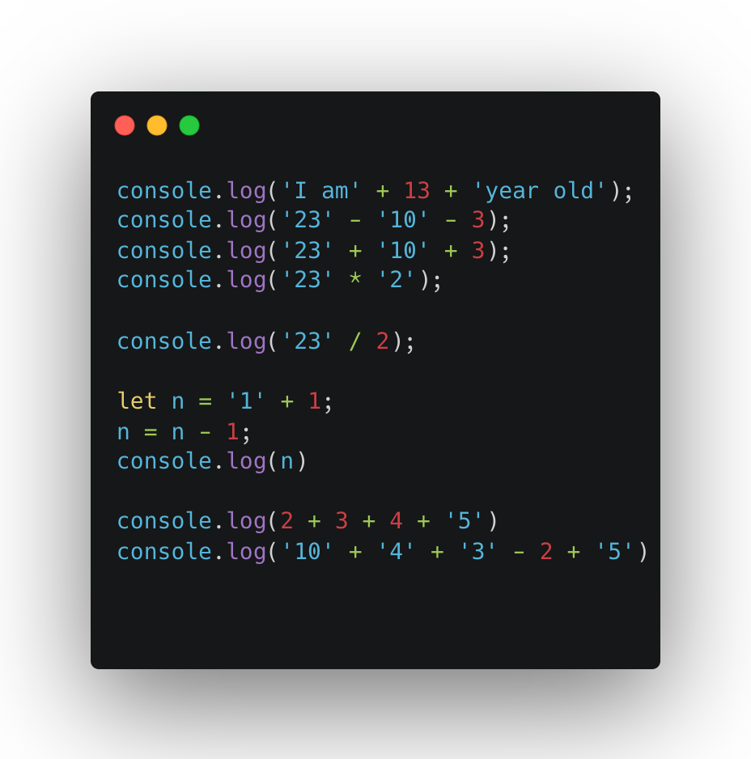
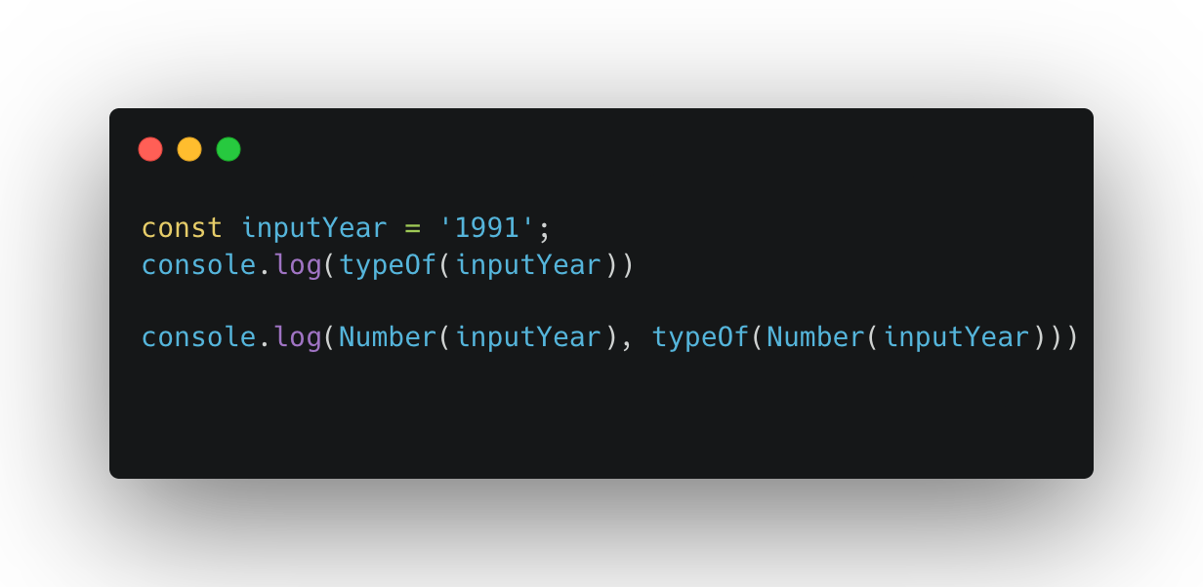
Conversion and Coercion

Slide 27
Quick Question (Boolean)
Output for “1” == 1
Output for “1” === 1
Output for 3 < 2 < 1
Output for 1 > 2 > 3

Slide 28
Alert and Prompt
In JavaScript, alert and prompt are functions used to interact with the user through pop-up dialogs.
The alert() function displays a message to the user in a pop-up dialog. It only shows the message and has an "OK" button to close the dialog.
The prompt() function displays a dialog with a message, a text input field, and "OK" and "Cancel" buttons. It is used to take input from the user.

Slide 29
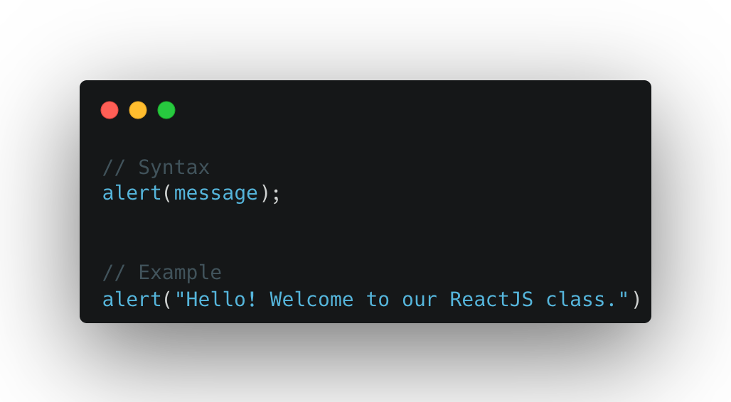
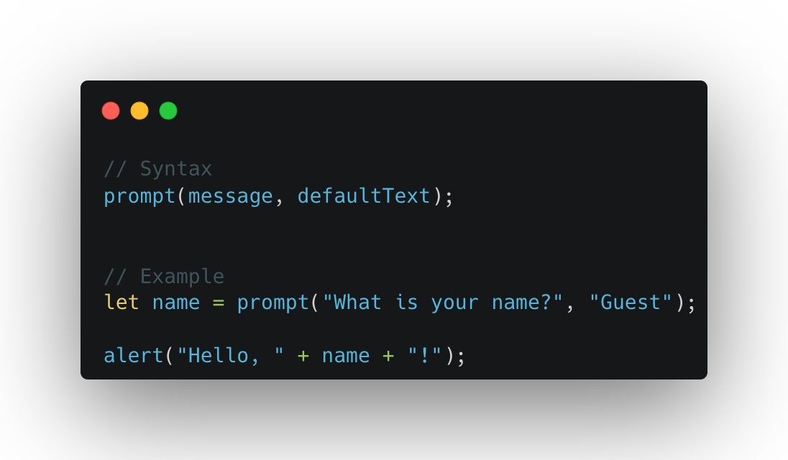
Alert and Prompt

Slide 30
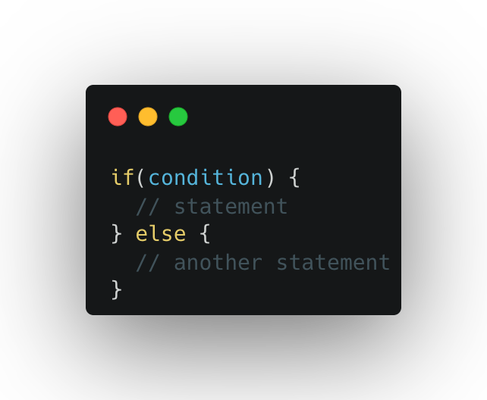
Taking Decision – If… else… statement

Slide 31
Feedback
What went well?
What went wrong?
What did you learn?

Slide 32
I believe that you learn the most if you don’t learn alone but find learning partners and other people with similar interest. - Unknown

